Slide 1
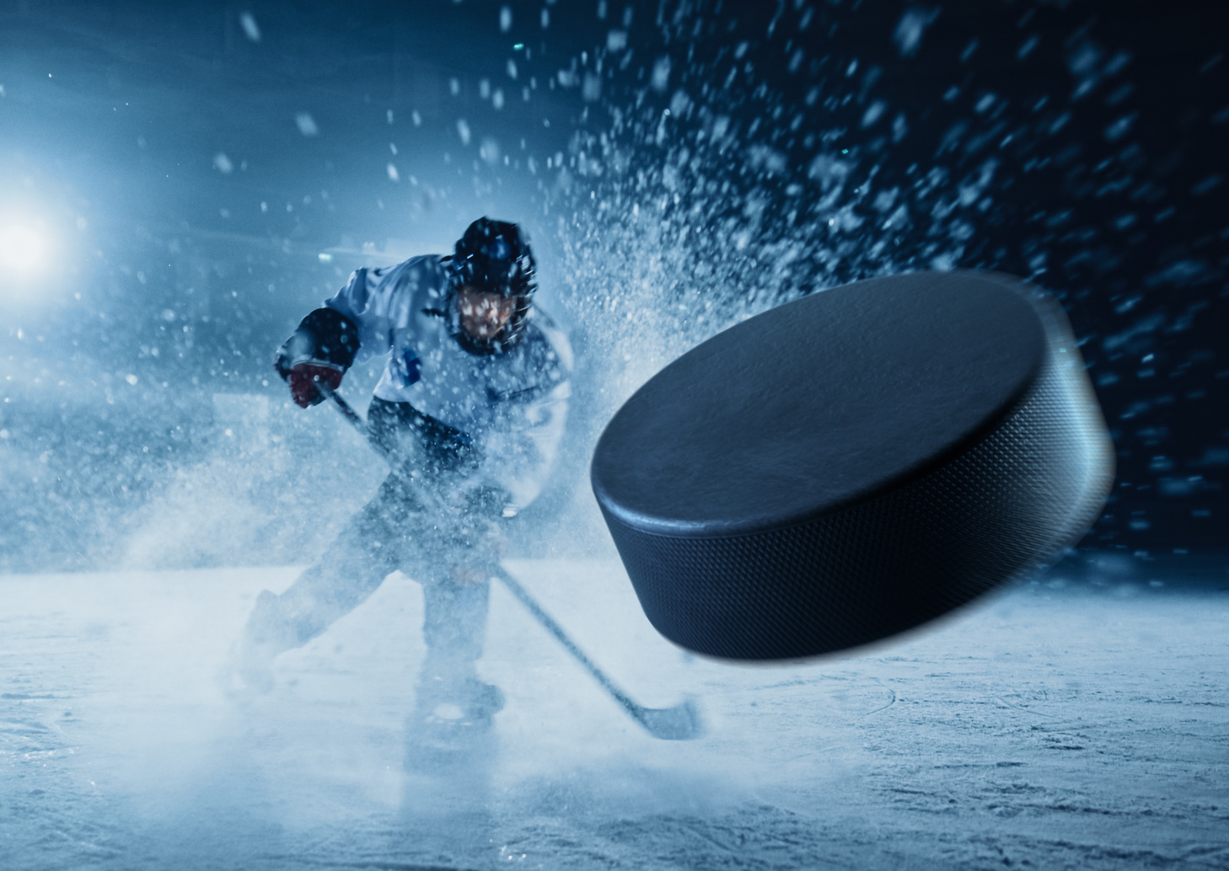
True Fans – NHL Stats App
CIS550 Final Project, Group 14
Jason Barnett, jabarnet@seas.upenn.edu
Molly O’Mara, momara@seas.upenn.edu
Yuhao Yan, yuhaoyan@seas.upenn.edu

Slide 2
Why True Fans
Provide more insightful information about the game of hockey for casual and non-hockey fans
Increase web engages to be quickly educated more about the game
Showcase players and teams that they can follow
More in-depth analysis views to keep them engaged
Help them become a “knowledgeable” hockey fans and help them speak the “Hockey Language”

Slide 3
Development Approach
Kaggle Dataset & Moneypuck Dataset

Slide 4
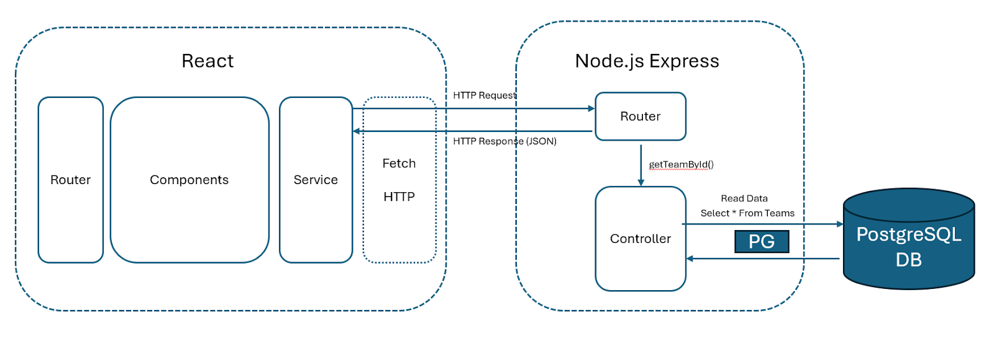
Architecture

Slide 5
Application Overview

Slide 6
Optimzation & Extras

Slide 7
Tech Challenges

